Slide 1
Who Are the Houthis?
The Recent History of Yemen
Activities Unlimited
History Club Presentation
Tom Butler 25March2024

Slide 2
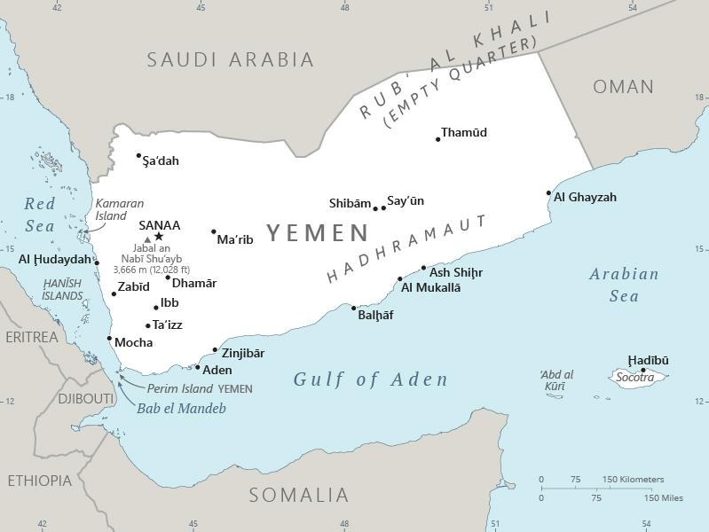
Yemen

Slide 3
Pre Cold War Yemen
A Brief Chronology
In biblical era, a powerful kingdom, Saba (Sheba) made wealthy due to its location as a transit point on the spice road and as main source of frankinsence and myrrh.
A Roman colony in the 1st century AD and called “Arabia felix”
With the collapse of Rome, control falls to the Sassanian Empire
Around 630 AD, Islam spreads to Yemen. Competing kingdoms and tribal groups
Ottoman control of Yemen in 1538 and on and off thereafter
British seize Aden in 1839 (protect route to India)
Notes:
The Greek geographer, Ptolemy, referred to Yemen as Eudaimon Yemen (fertile Yemen)

Slide 4
Post Ottoman Empire Developments
  Collapse of Ottomans during WW I
  WWI peace settlement: Treaty of Sevres & Treaty of Lausanne created new states and boundaries (Jordan, Iraq, Syria and British Mandate for Palestine)
  Arabia broadly defined by historical areas and unified under Abd al-Aziz as Saudi Arabia in 1932, including disputed territory in northwest Yemen. (Saudi Kingdom not recognized by Egyptian king (Faruk) until 1936; N Yemen had accepted loss of territory in 1934)
  Northern area of Yemen declared itself as an independent kingdom in 1918 (Mutawakilite Kingdom 1918-1962)
  British maintain control of Aden and surrounding area (Aden Protectorate)
  Effectively a North Yemen and a South Yemen until 1990 unification

Slide 5
Sunni and Shia Population
About 60% Sunni and 40% Shia
Yemeni Sunnis follow a moderate Islamic School of Law (Jafari) and reject the extreme Wahabi practices of Saudi Arabia. Source of tension
Usually there was a harmonious religious mix among Yemeni, but Sunnis were generally on the lower rung of society and Zaidis dominated.
The Shia Zaydi sect is almost exclusively found in Yemen. (Zayd ibn Ali was great grandson of Ali, son in law of Mohammed and he led an 8th century revolt against Ummayad Caliphate. The Zaidi are also know as “Fivers” as they view Zayd ibn Ali as the last true Caliph. They broadly follow the moderate Hanafi School of law. (Allah gave man reason in order to understand the teachings of Koran. Zaydi Shia make use of “ijtihad” (interpretation and “qui’ya’” (analogies). They differ from mainstream Shia in that they do not acknowledge an Ayatollah who alone interprets the Koran. This sect views Zayd as a model of incorruptibility. Thus, they recognize as religious/political leader the imam considered most free of corruption/most learned in religion. If Imam goes astray, can be replaced.

Slide 6
The Cold War and Yemen
Egypt and Saudi Arabia good relations from 1936 until military coup deposed King Faruq in July 1952.
Military rivalry within Egypt until Nasser consolidated control
in 1954.
1956: Nasser nationalized Suez Canal. Vision of pan-Arab union
1957: Nasser aligns Egypt with Russia (supplied weapons)
1958: Egypt and Syria form the United Arab Republic (UAR)

Slide 7
Cold War Rivalry: US and USSR Proxies
1958: US military sent to Lebanon to stifle any Nasserism sentiment
1960: Mutawakil Imanate on shaky ground- seeks Nasser support by joining “United Arab States” and requesting Egyptian and Russian military training. With 1961 exit of Syria, the UAS falls apart. Nasser advisors leave North Yemen; Russians remain.
Nasser’s new vision now is to end Mutawakilite rule and use Yemen as a base to topple the Saudis and control north and south Yemen (Aden Protectorate).

Slide 8
Egypt-Saudi Arabia War in Yemen
  1962 Imam Ahmed dies; Muhammed al-Badr new Imam. Military overthrows him and declares Yemen Arab Republic, supported by Egypt.
  Saudis and Jordan (and many Houthis) back the “royalists” supporting the former king. JFK on advice of CIA backs both Saudis and “royalists.”
  Eight years of civil war with heavy involvement of Egypt and Russia on the YAR side and US supporting the Saudis, but at same time recognizing the YAR. By 1966, Egypt had 70,000 troops bogged down in Yemen. UK and Israel providing mercenaries and weapons to royalists
  Israeli war of 1967 forced Egypt to abandon Yemen as King Faisal and Nasser agreed to end all military support. Final cease fire reached by two sides in 1970.
  1978 Ali Saleh takes control; remains in power until Arab Spring

Slide 9
Meanwhile in the South
  Aden is next to fall. British leave Aden in 1967 in the midst of civil war. National Liberation Front takes control (1970) and declares People’s Dem. Republic of Yemen. (PDRY). PDRY backed by Russia.
  North Yemen and South Yemen continual conflict in 1970’s characterized by instability and numerous assassinations.
  Carter intervention (in 1979 provided 18 F5’s and Taiwanese pilots with Saudis covering the cost) resulted in final cease fire. Nonetheless, continual fighting back and forth in 1980’s. 1986 PDRY leadership in South splinters as Russian financial support dries up.
  Oil exploration around North/South border areas led to unification in 1990
  Ali Saleh, controlling the military becomes sole ruler of unified People’s Republic of Yemen in 1992 (President and General of the Army)
  Yemen pretty much a backwater in the 90’s, but in 2000’s courted by US to help in “war on terror.” Ali Saleh managed situation by providing some support in war on terror while also appeasing the Saudis by allowing Wahhabism to spread within Yemen.

Slide 10
Rise and Revolt of the Houthis
Houthis follow the Zaidi sect of Shia Islam
Mainly found in mountainous, northwest of Yemen
Historically, the Houthi clan was prominent and viewed as highly religious (claimed descent from family of Ali).
Enjoyed broad autonomy for centuries as they resisted both Saudis and Ottomans; effectively acted like a shadow government behind the scenes while serving as Imam/Mutawakil (usually a Houthi).
More significantly, Zaydis were sidelined by Saleh interests and lost privileges and business opportunities. “No longer the elite”

Slide 11
Saleh and the Houthi
Following the 1962-1970 war, Saleh sought to consolidate his position by marginalizing the Houthi clan. Military Governor of Taiz, 1970-1978; then President. One avenue was to get closer to Saudi Arabia by promoting Wahhabism. During the 80’s opened religious centers, including in Saa’da; allowed Saudis to operate schools and widely proseletyze. Southern coastal mountains (Hadramaut) center of extremism; homeland of bin-Laden clan
As Saleh corruption and impoverishment of the country grew, Houthis emerged as leaders of opposition to Saleh in 1990’s.
Hussein al Houthi formed al-Haqq (Truth) Party in 1993 in opposition to Saleh’s majority Islah (Reform) Party and entered the “assembly.” The Islah Party was strongly influenced by Saudi religious interests. Saleh tried to play the parties off one against another, but still heavily supported Islah as he viewed the Houthi to be the greater threat to him.

Slide 12
Houthis: From Politics to Revolt
Hussein leaves Assembly in 1997 and focuses on building up a youth movement, Believing Youth (reawakening of religious sentiment); increasingly critical of Saleh (personal corruption and Wahhabi support).
2000 Saleh border agreement with Saudis and efforts to disarm the Houthis enflame the situation. Continual skirmishes.
2003 invasion of Iraq and broader war on terrorism, led to a more radical Houthi movement. (Ansar Allah- adopts Hezbollah slogans.)
2003 Houthis begin to receive assistance from Hezbollah and Iran mainly providing military training and some arms.
Movement spreads among wider Zaydi community and rebellion grows mainly with internal support.

Slide 13
Civil War, Again
External support made Houthis a greater threat. Saleh initiates military campaign (2004) to suppress movement. Off and on bombing and fighting continues. Hussein al-Houthi killed in 2004 bombing of Sanaa. His brother, Abdul Malik al-Houthi is new leader
Massive offensive in 2009 and again in 2010 to end Houthi threat (Operation “Scorched Earth” and “Blow to the Head”). US (Obama) sees Saleh as ally in fight against terrorism.* Saleh’s attacks on Houthis are unsuccessful. Houthis, with popular support, effectively resist Saleh and even mount an attack on Saudi Arabia and defeat Saudi response.
*Considerable evidence suggests Saleh secretly aided Sunni terrorists to garner more US support.

Slide 14
Arab Spring: Impact on Yemen
2011-2012 saw widespread uprising against Saleh’s corruption and military control. Saudis ready to drop support, but Obama urges calm and continued support for fear of chaos that would benefit terrorism.
Assassination attempt on Salah June, 2011. Medivacced to Riyadh and replaced by VP Hadi. Elections in 2012 (Hadi only candidate) and creation of federal provincial structure. Houthis felt cheated out of territory by this plan. A recovered Ali Saleh returned In late 2012, but had now lost his leadership role
2014 Houthis secretly open talks with Saleh and he joins Houthis. Sanaa captured in January, 2015. With assistance from Iran, the Houthi/Saleh alliance moves on Aden.
2015 Pres. Hadi flees Aden to Riyadh. New Saudi King, Salman, cedes foreign policy portfolio to Crown Prince, “MBS” who makes decision to go to war against Yemen, expecting it to be over in a few months.(MBS was expecting Pakistan to provide boots on the ground, which never materialized.)
Saudi war on Yemen was not opposed by a US focused on anti-terrorism and avoiding chaos and was ultimately supported with munitions and intelligence.
Saudis had limited success in creating a coalition for its “Operation Decisive Storm” but did get a UN Security Council Resolution (April 2015)approving use of force to restore Hadi and impose an arms embargo on the Houthis/Saleh. Fearful of alienating the Saudis, US put little pressure on Saudis and MBS was broadly feted during his lengthy US tour in 2016. MBS and US greatly exaggerated Iran support, which was still marginal at the time (~$10mm/yr and a few advisors). (This did increase after nuclear deal ended and Iran provided experts and technology to develop more sophisticated rockets and drones)

Slide 15
US Policy and Yemen 2016-2017
Driven by “war on terror” and alternating Iran nuclear deal or no deal. In this environment, foreign states were really calling the shots
Trump first term accepted MBS and Netanyahu characterization that Yemen/Houthis was a pawn of Iran and therefore could not be allowed to win. US administration fulsomely supported blockade that stopped food imports which led to widespread starvation.
By 2017, evident that Saudi Arabia caught in a quagmire, sucking up money and resources. Houthis controlled most of the north and were strongly supported by population for protecting Yemen from the “Wahhabi” invaders. Saudis and UAE sought to split Saleh off from the Houthis and Saleh seemed ready to accept. He was assassinated December, 2017 a few days after announcing his change of sides.

Slide 16
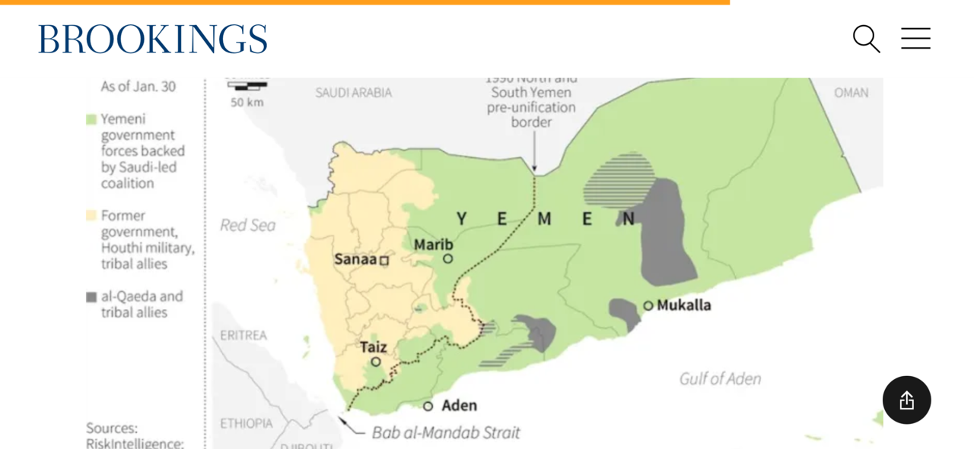
Yemen 2017

Slide 17
Yemen, Khashoggi and Covid, 2018-2020
MBS’ butchering of Khashoggi in Istanbul shocked US and brought into question support of MBS. Ultimately, Administration stood by Saudi Arabia, but public opinion and Congress put pressure on Trump to find ways to reduce hostilities in Yemen.
Sec. Mattis pressured MBS and UAE not to seize port of Hudaydah, as planned, and supported the Stockholm Agreement (12/2018) for cease fire at the port. UAE withdrew its troops to the south in 2019. (gradual winding down its support).
Conditions seemed to be improving when Covid arrived with devastating effect on the Yemeni population, already half starving and medical resources destroyed in bombings. Before leaving office, Trump designated Houthis as a Foreign Terrorist Organization (FTO) which cut off most aid to Yemen

Slide 18
Biden: More of the Same
Biden promises to end war in Yemen and cut off offensive weapons.
But focused on Iran and nuclear deal, not Yemen. Afghan withdrawal, (8/21) further limited his ability to change foreign policy, though he removed FTO. Arms sales to Saudis continued unchanged
Iran strengthens relationship with Yemen; appoints first Ambassador
March, 2022, Russia invades Ukraine. Who cares about Yemen now.
April, 2022 UN arranges 60 day cease fire that holds up beyond 60 days.
October 7 carnage reignites passions in the Middle East and Yemen takes on role of ”proxy for Hamas” and terrorizes/disrupts ships heading to Suez Canal.

Slide 19
Trump, 2025: Early Indicators
Houthis stopped Red Sea attacks and released captive seamen when Gaza cease fire implemented. Red Sea shipping did not resume due to fragility of cease fire.
US resumes bombing of Houthis on March 15-16.
With both sides claiming the other had broken the cease fire, Israel resumes bombing of Gaza on March 18
Houthis resume firing rockets and drones in response, targeting Israeli shipping in the Red Sea.
Consequences of Houthi attacks on shipping and increasingly harsh rule has led to a weakening of support among Zaydi populace. (common expression: “our Shia Taliban”)
WHERE DOES YEMEN GO FROM HERE??

